Slide 1

Smart Contract / Solidity Complete Tutorial
Components Of Smart Contract
Tutorial :2

Slide 2
What is Smart Contract
A "smart contract" is simply a program that runs on the Ethereum blockchain. It's a collection of code (its functions) and data (its state) that resides at a specific address on the Ethereum blockchain.
A smart contract is a computer program or a transaction protocol which is intended to automatically execute, control or document legally relevant events and actions according to the terms of a contract or an agreement.

Slide 3
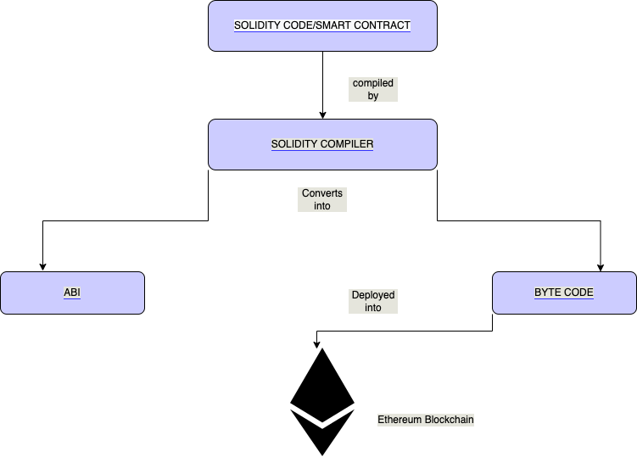
Components of Smart Contract
High level Diagram

Slide 4
Demo Using Remix Ide
How to use Remix ide
How to get byte code and abi
Byte code to opcode
Deploy contract to Ethereum block chain

Slide 5
Summary
Smart Contract
ABI
Byte code
Ethereum Blockchain

